Slide 1
Pop Art
An art movement started in the 1950’s
It challenged the traditional fine art by incorporating images seen in popular culture (news, advertisements, comic books, mundane objects)
These cultural icons were typically viewed as kitschy

Slide 2
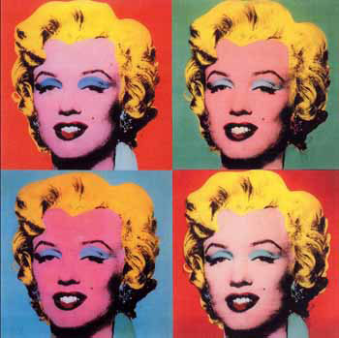
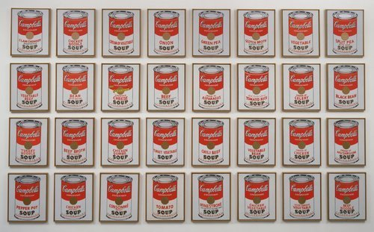
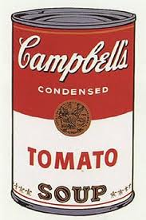
Famous Artists of Pop Art
Andy Warhol
Campbell’s Soup Cans, 1962
Marilyn Monroe, 1967

Slide 3
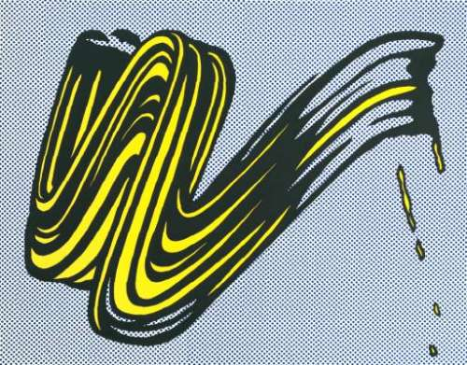
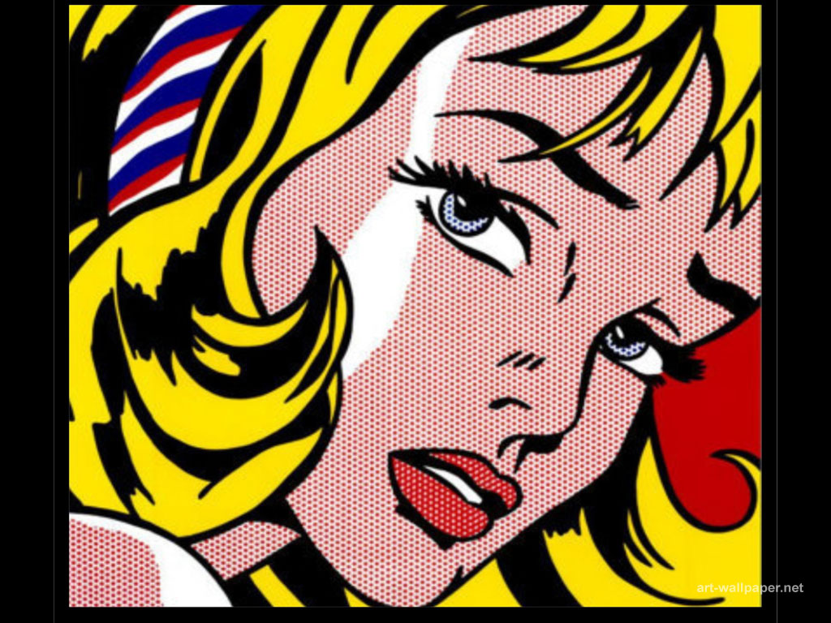
Roy Licthenstein
Brushstroke, 1965

Slide 4
Claes Oldenburg
Swedish American sculptor (Born in1929)
Best known for his public art installations of replicas of enlarged everyday objects
And
Diverse medium used in his sculptors (soft sculptor)
Artwork is viewed as whimical and insightful

Slide 5
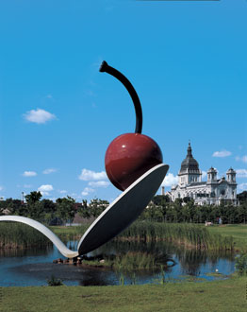
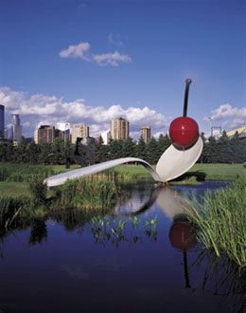
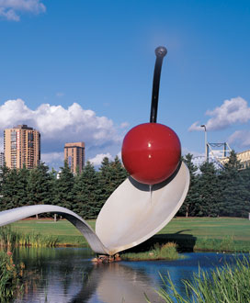
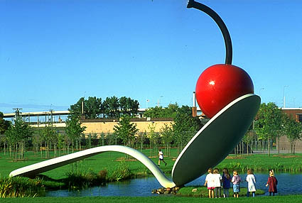
Spoonbridge and Cherry, Minneapolis
1988

Slide 6
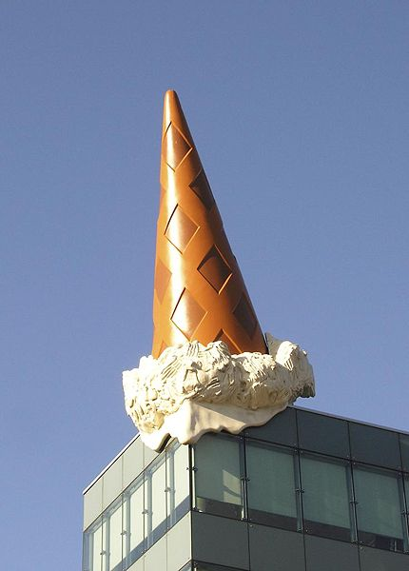
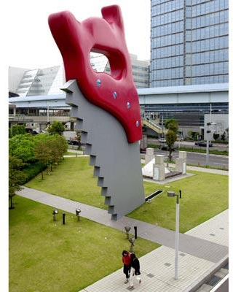
Saw, Sawing, Tokyo, Japan
1996
Dropped Cone, Cologne, Germany
2001

Slide 7
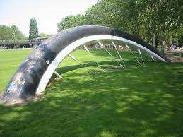
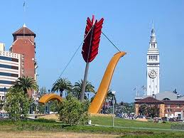
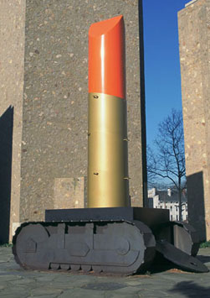
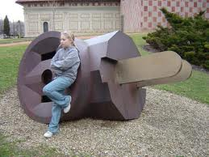

Slide 8
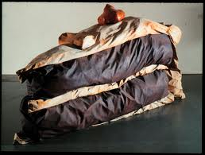
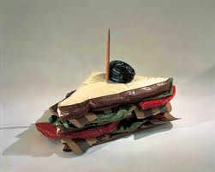
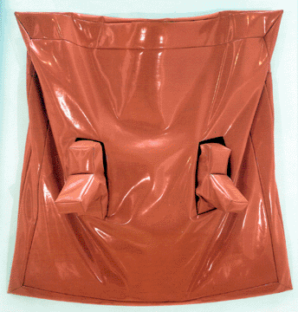
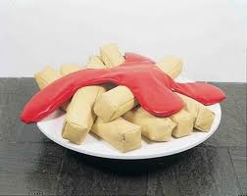
Soft Sculpture

