Slide 1
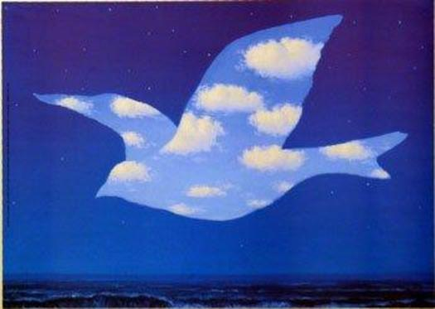
An eye for Magritte

Slide 2
Art History
René Magritte (1898- 1967) was surrealist artist
Surrealism- is a form of art that uses fantasy or dreamlike images to express ideas
Magritte is well known for his witty artworks
He wanted to symbolize the idea of reflection by having viewers think about what they were really looking at

Slide 3
Vocabulary
Symbolize- to represent or to stand for
Reflection- to give back and show an image

Slide 4
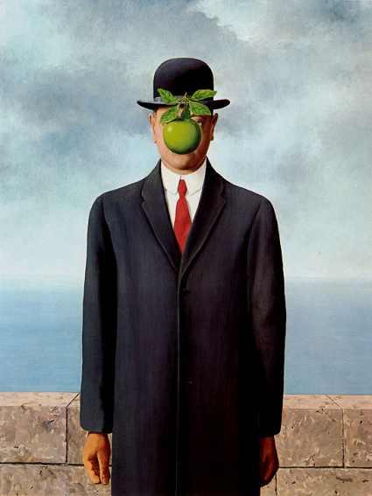
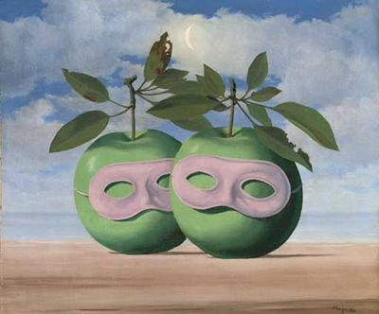
Surrealism

Slide 5
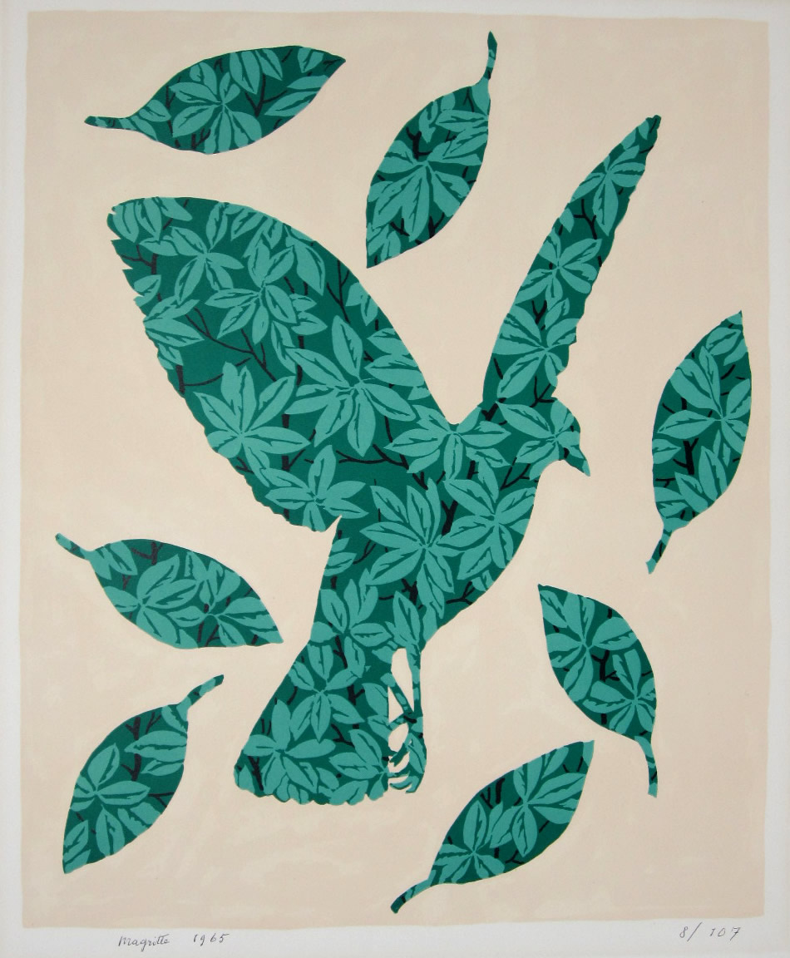
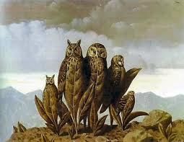

Slide 6
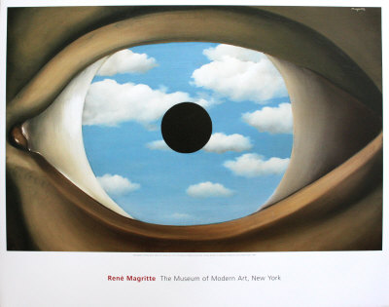
René Magritte
The pupil is black the iris is a reflective background

Slide 7
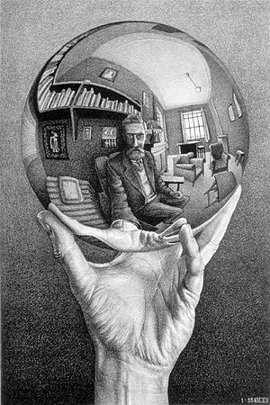
Reflection
M.C. Escher

Slide 8
Your Turn
Create an eye that has an iris that reflects a sight you enjoy seeing. It can be a favorite place you like to go, a favorite food, something you see around the room, your choice.

