Slide 1
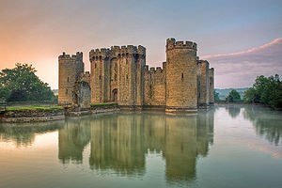
Mediaeval/Renaissance

Slide 2
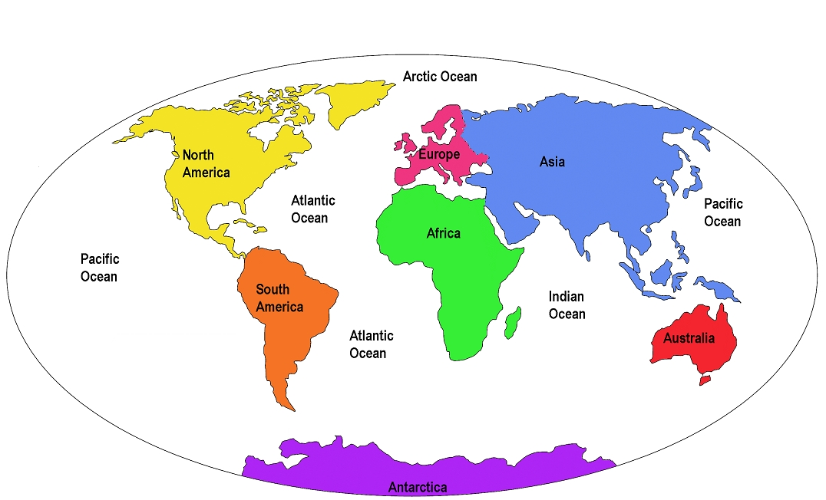
Middle Ages
Started in the 5th Century (400 AD), we are in the 21st Century (2012 AD)
A time of nobility (Kings, Queens, Knights) and castles, in Europe

Slide 3
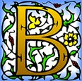
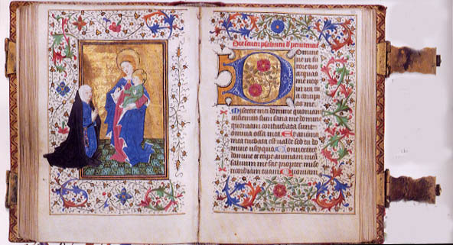
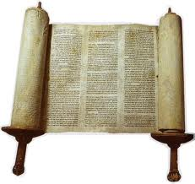
What are Illuminated Letters?
Illuminate means to fill with light
Illuminated letters are an art form that is richly decorated with colorful and gilded patterns or designs typically seen in manuscripts.
Manuscripts are a form of handwritten documents (bibles, books, scrolls), mostly used in the Middle Ages

Slide 4
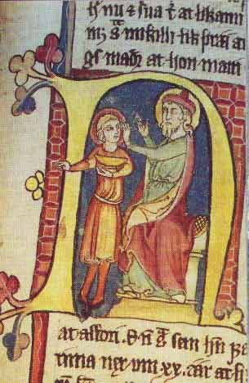
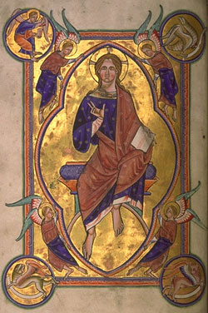
From manuscripts

Slide 5
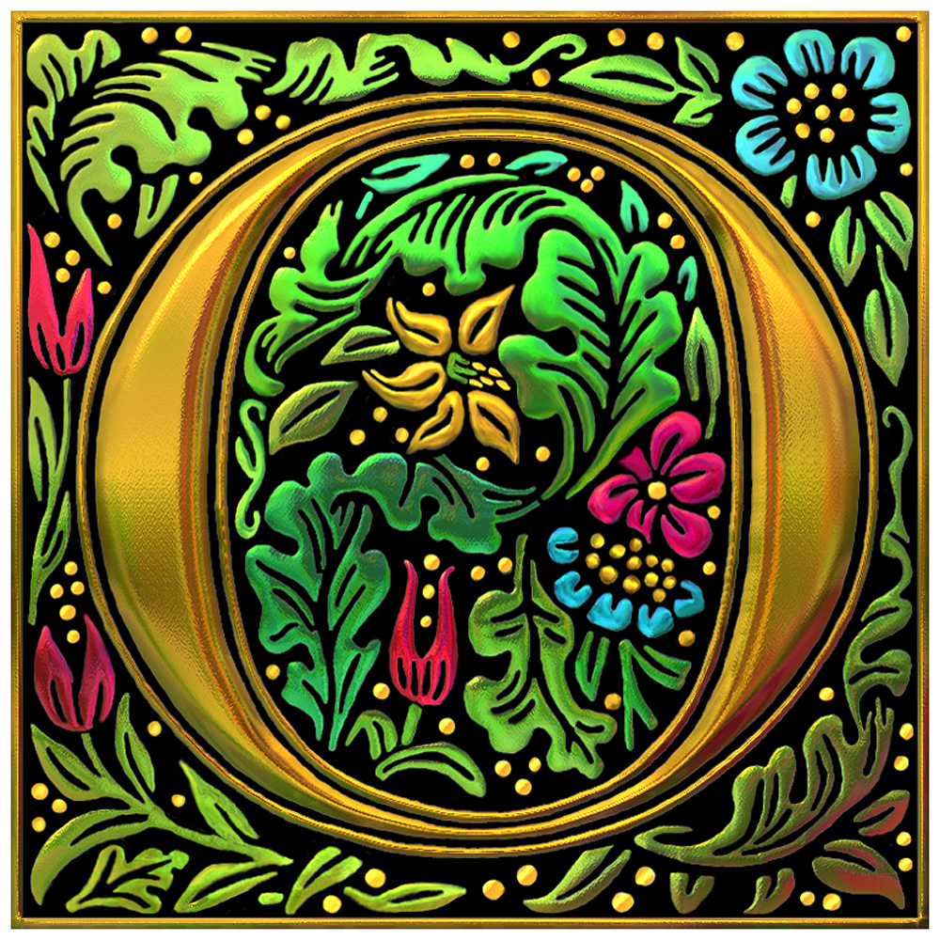
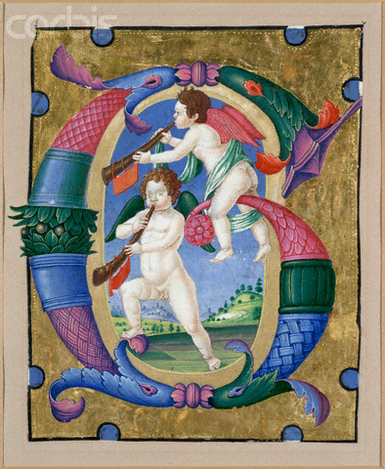

Slide 6
Borders

Slide 7
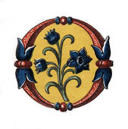
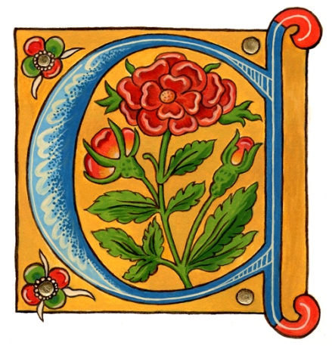
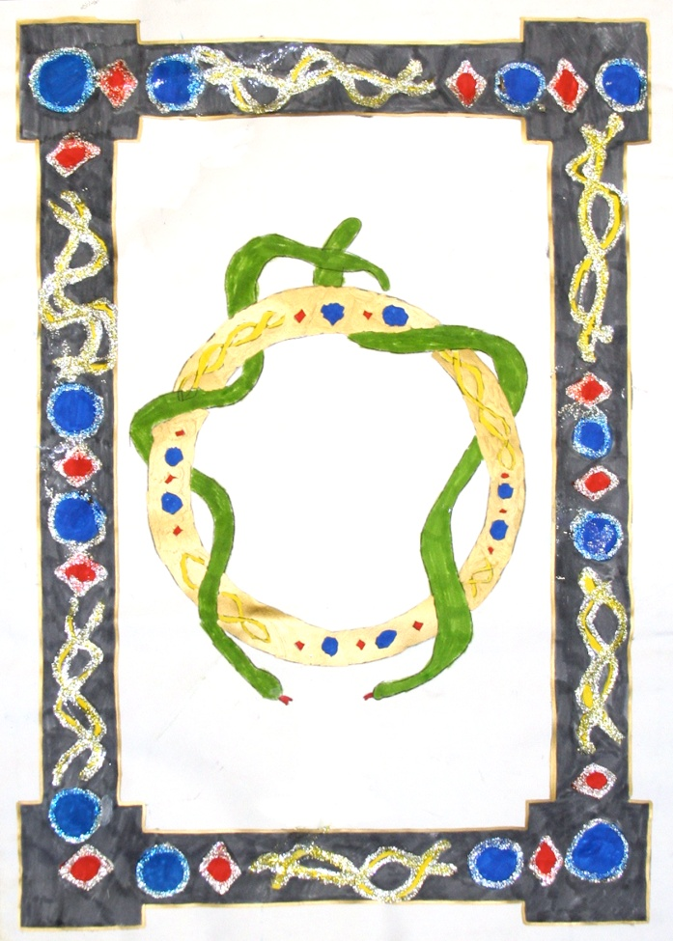
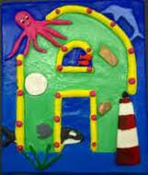
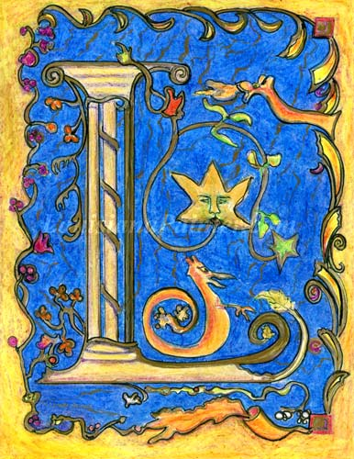
Themes
A unifying or dominant idea

Slide 8
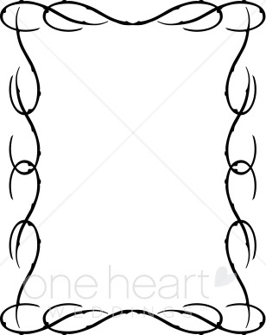

Slide 9
