Slide 1
What is a Symbol?

Slide 2
Symbol-an image that represents or stands for an idea
There are many types of symbols, colors, shapes, words or phrases, numbers, flags

Slide 6
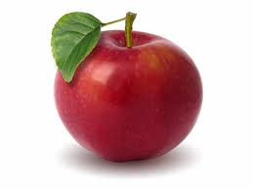

Slide 8
What represents you?
Your favorite color?
A place you enjoy going to?
Your family?
Hobbies?

Slide 9
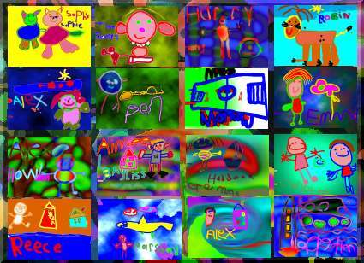
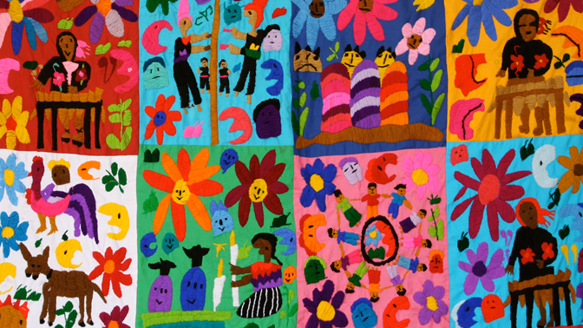
Diversity Quilts

Slide 10
I want you to
Draw 4 different sketches that symbolize (represent) you

